Slide 1

Manikanta Maddula

Slide 2
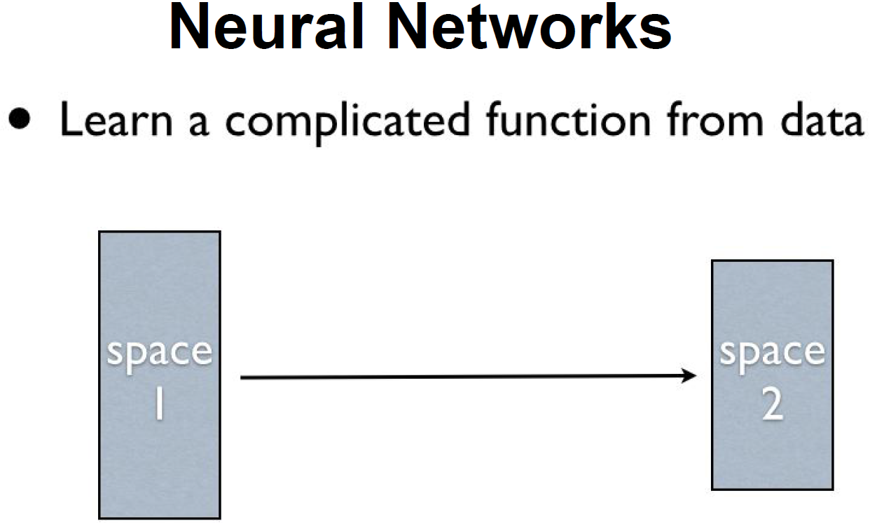

Slide 3
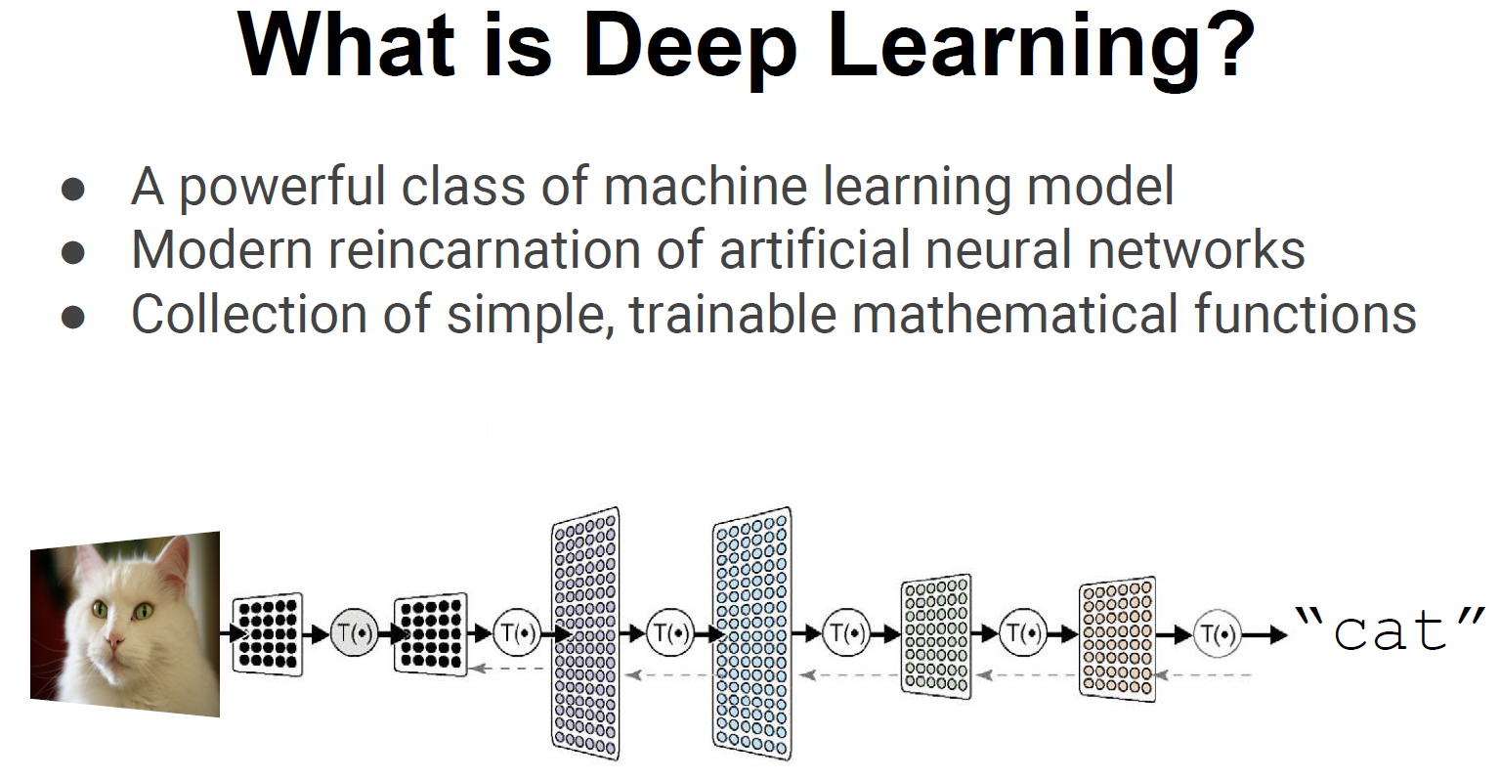

Slide 4
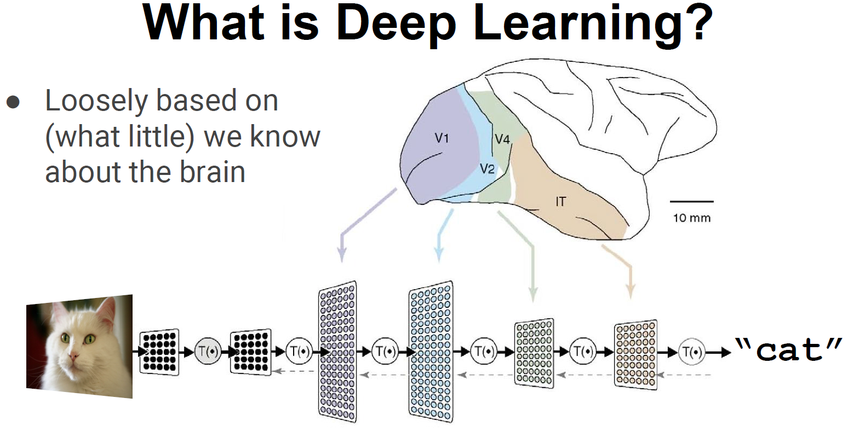

Slide 5
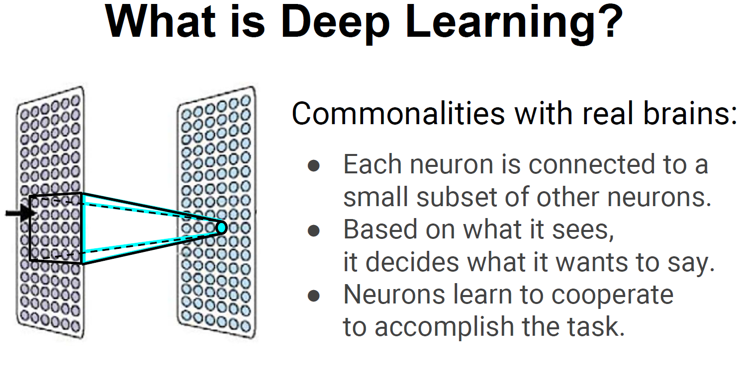

Slide 6
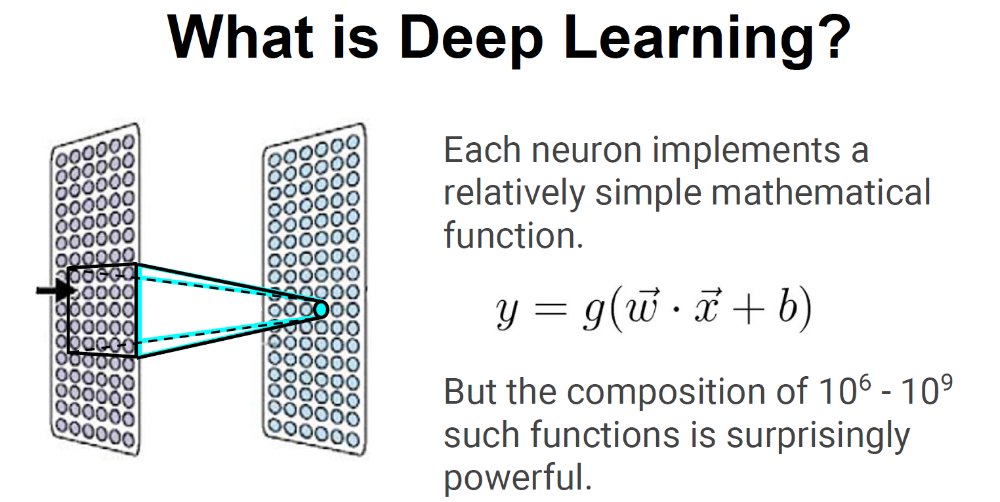

Slide 7
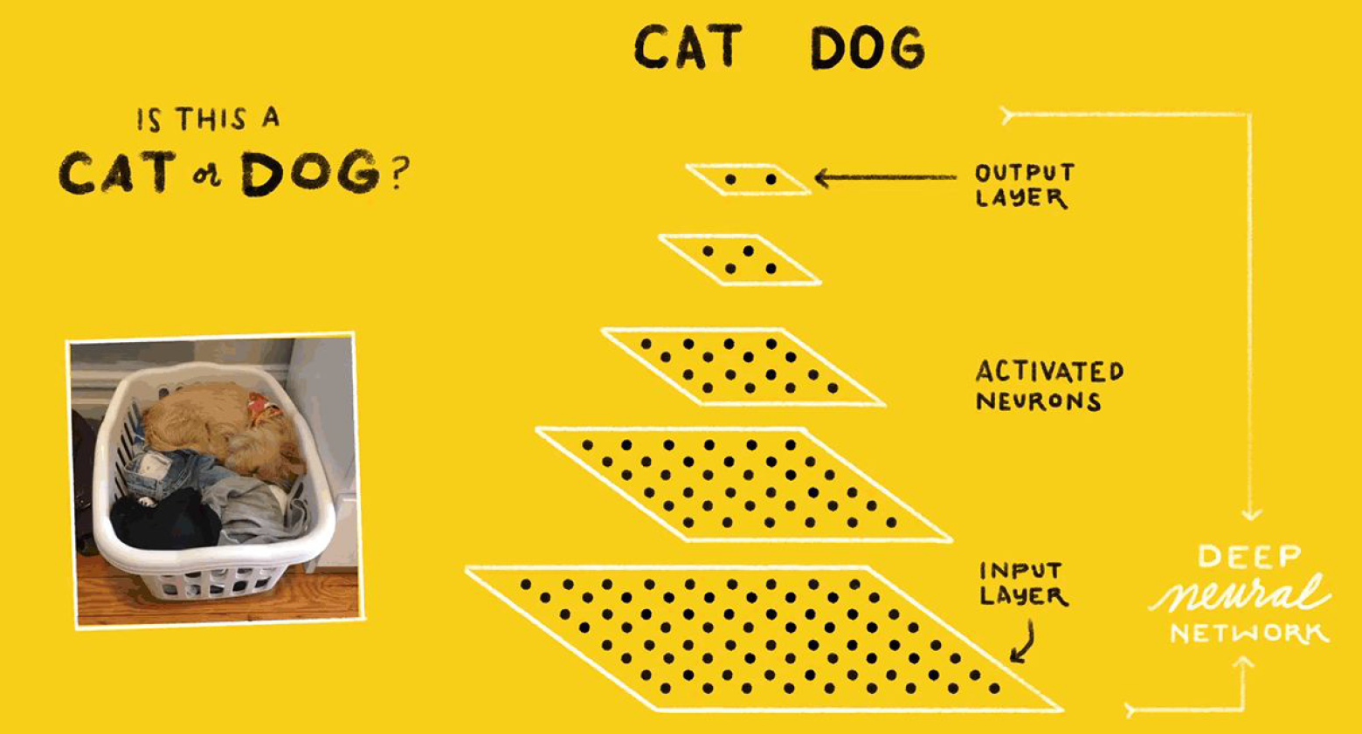

Slide 8
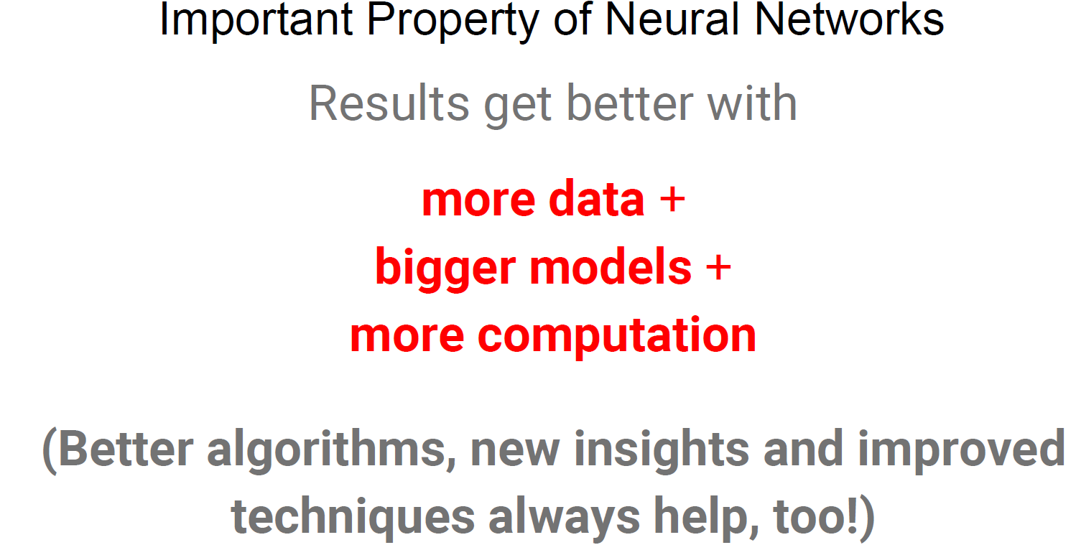

Slide 9
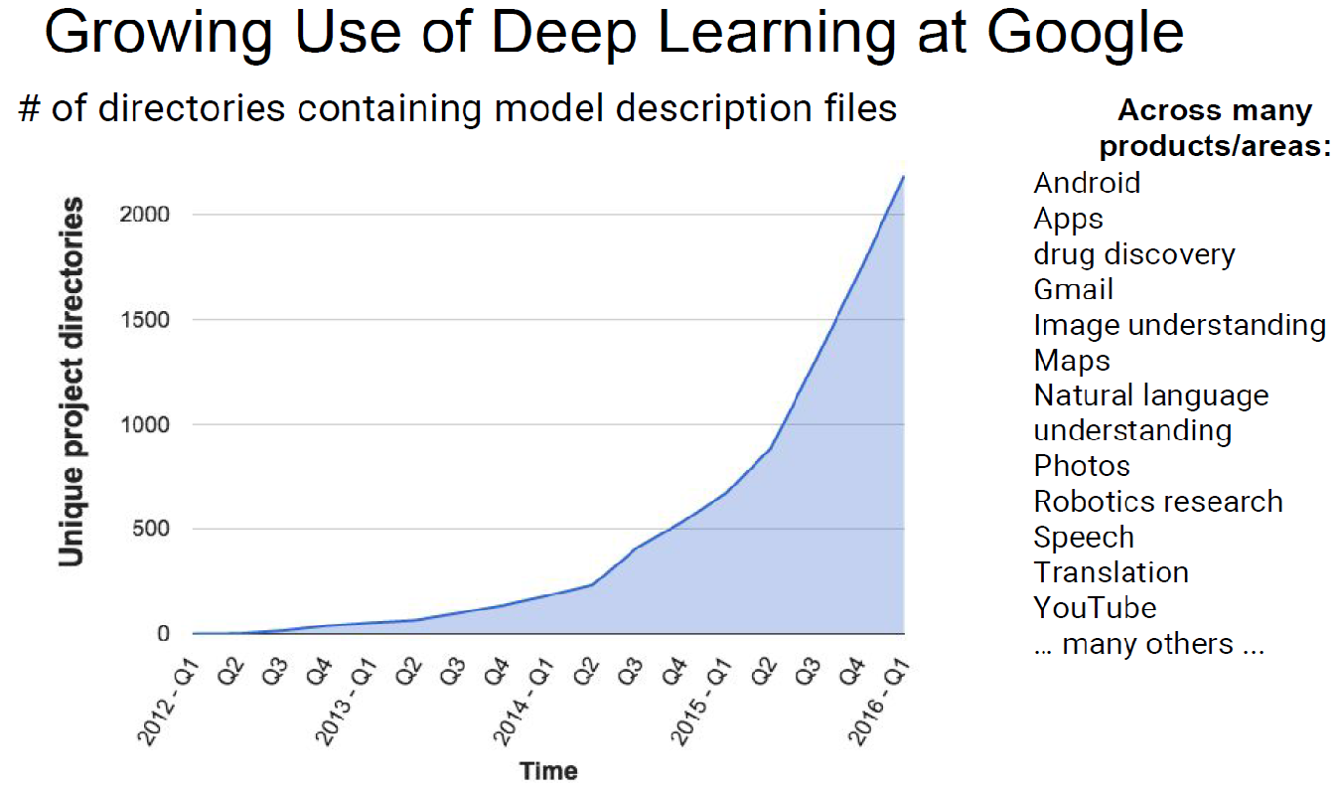

Slide 10
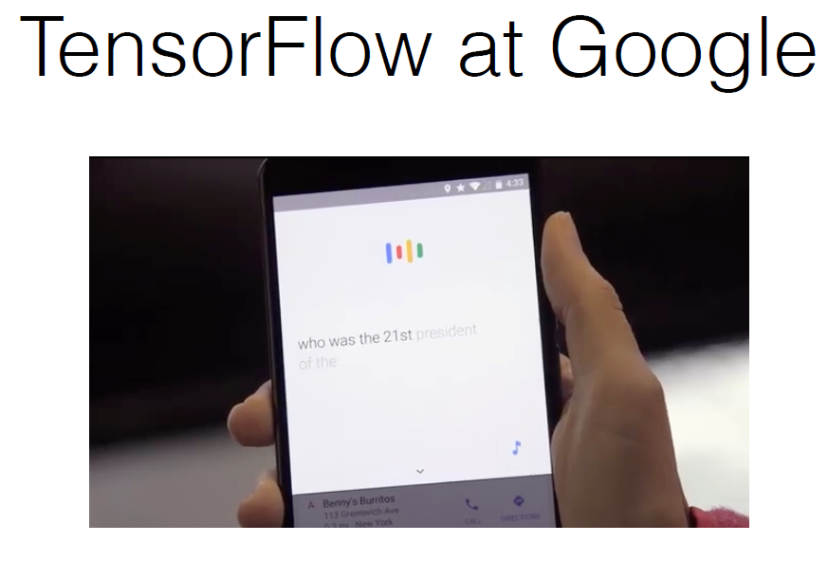

Slide 11


Slide 12


Slide 13
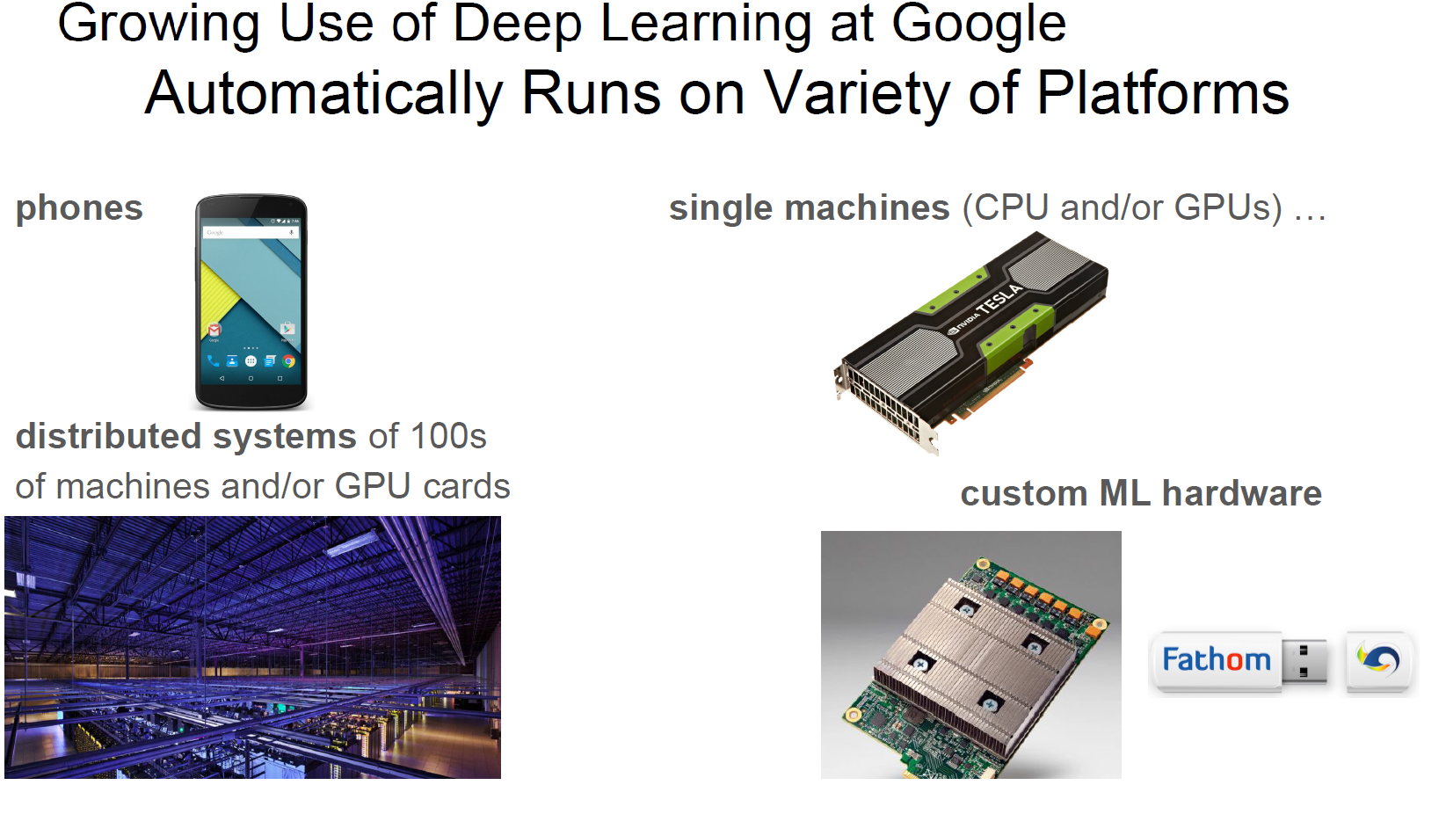

Slide 14
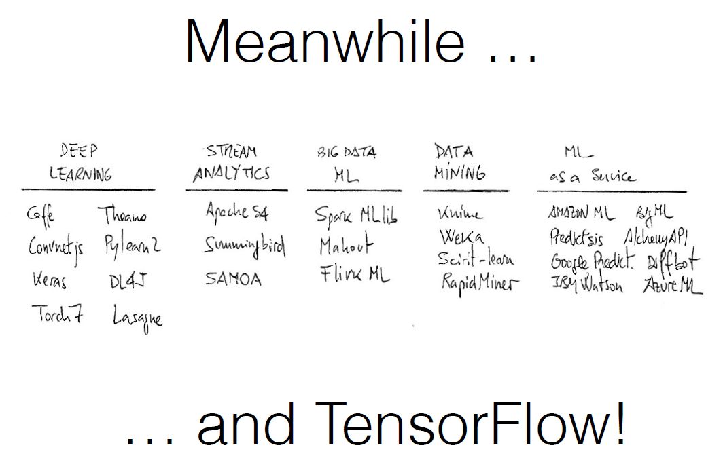
-*

Slide 15
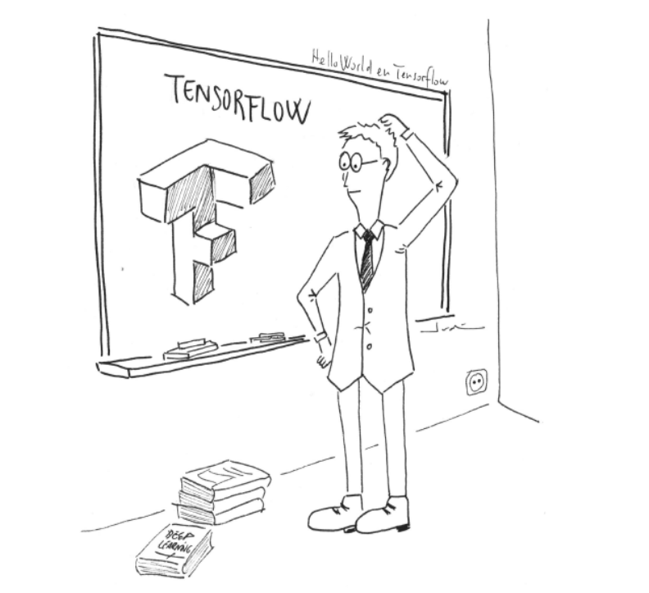

Slide 16
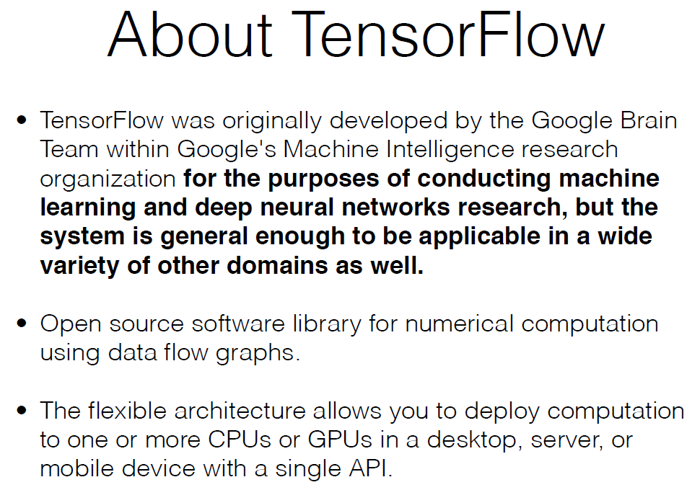

Slide 17
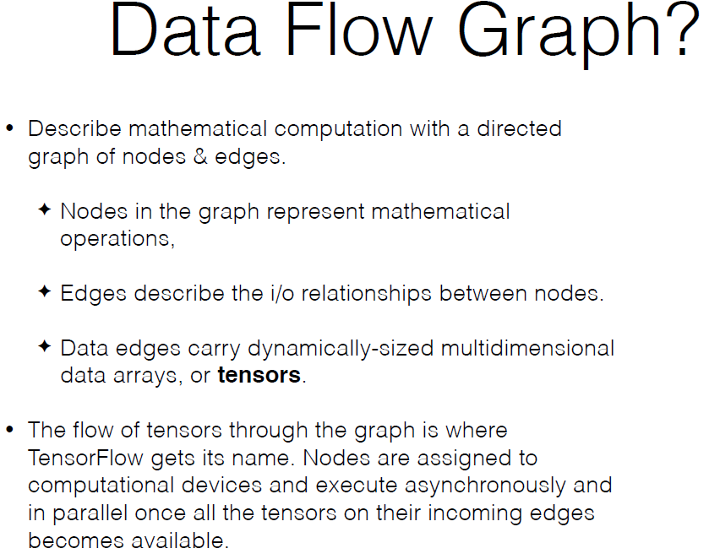


Slide 18
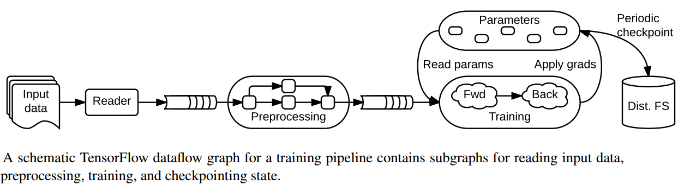

Slide 19
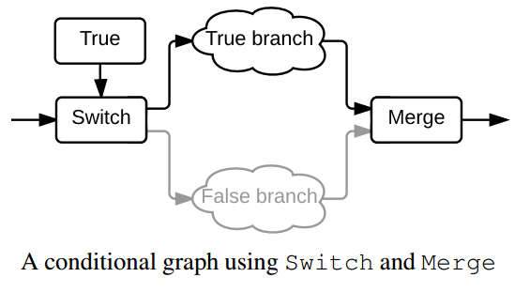
Dynamic Control Flow

Slide 20
Computation Graph
TensorFlow programs are usually structured into a construction phase, that assembles a graph, and an execution phase that uses a session to execute ops in the graph
We program to assemble the graph
The TensorFlow Python library has a default graph to which ops constructors add nodes
The TensorFlow Python library has a default graph to which ops constructors add nodes
TensorFlow relies on a highly efficient C++ backend to do its computation. The connection to this backend is called a session.
InteractiveSession is to interleave operations
We can also enter a session with a “with” block. The session ends automatically

Slide 21
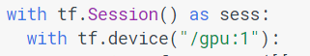
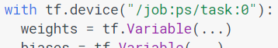
Session
CPU or GPU
Launching the graph in a distributed graph
We can use "with tf.device():" statements to directly specify workers for particular parts of the graph:

Slide 22
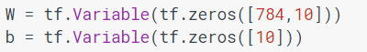
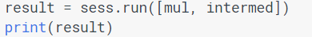
Variables, fetches
Variables maintain state across executions of the graph. It lives in the computation graph
Before Variables can be used within a session, they must be initialized using that session
To fetch the outputs of operations, execute the graph with a run() call on the session object and pass in tensors to retrieve
All the ops needed to produce the values of the requested tensors are run once (not once per requested tensor)

Slide 23
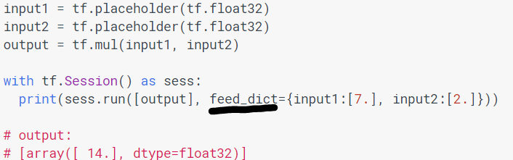
Feeds
feed mechanism for patching a tensor directly into any operation in the graph
A feed temporarily replaces the output of an operation with a tensor value.
Supply feed data as an argument to a run() call

Slide 24
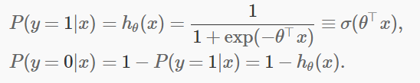
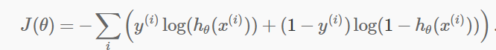
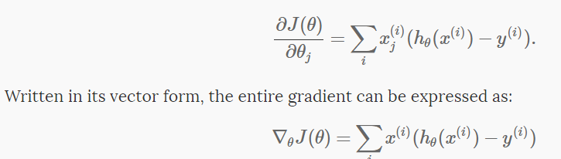
Logistic regression
Learning function
Cost function

Slide 25
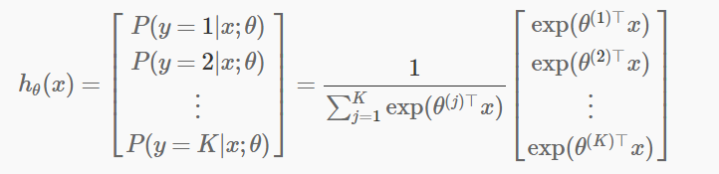
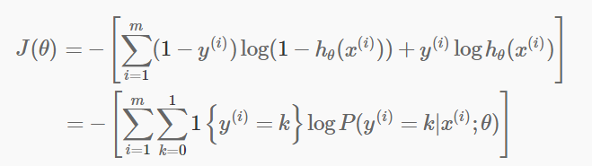
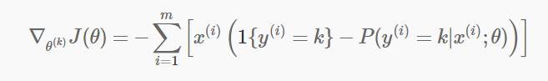
Softmax Regression
Cost function

Slide 26
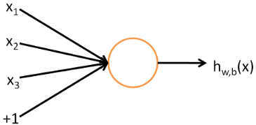
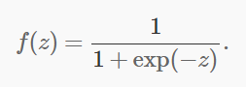
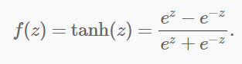
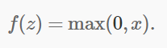
Neural networks
If the activation function is sigmoid function then single neuron corresponds exactly to the input-output mapping defined by logistic regression
Sigmoid, tanh, rectifier

Slide 27
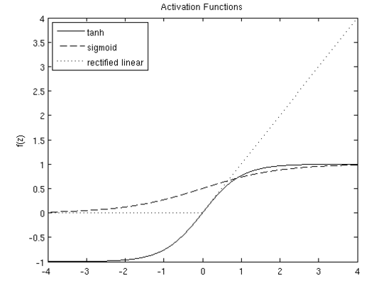
Activation Functions

Slide 28
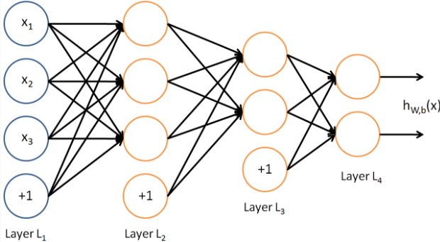
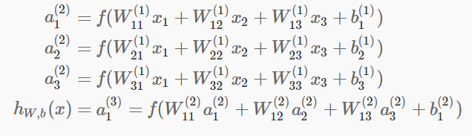
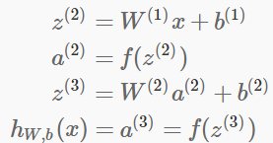
Multi Layer Perceptron
Feed forward

Slide 29
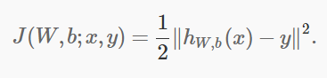
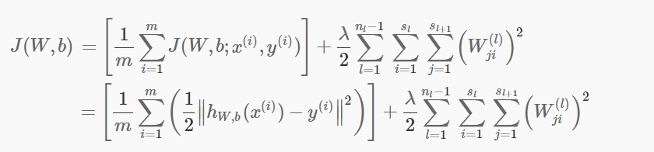
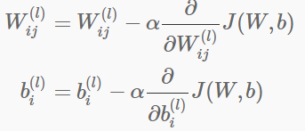
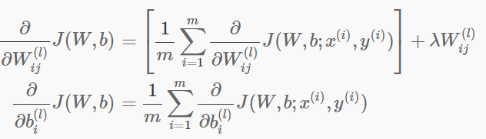
Backpropagation Algo
Regularization
Gradient descent
Derivative of overall cost function

Slide 30
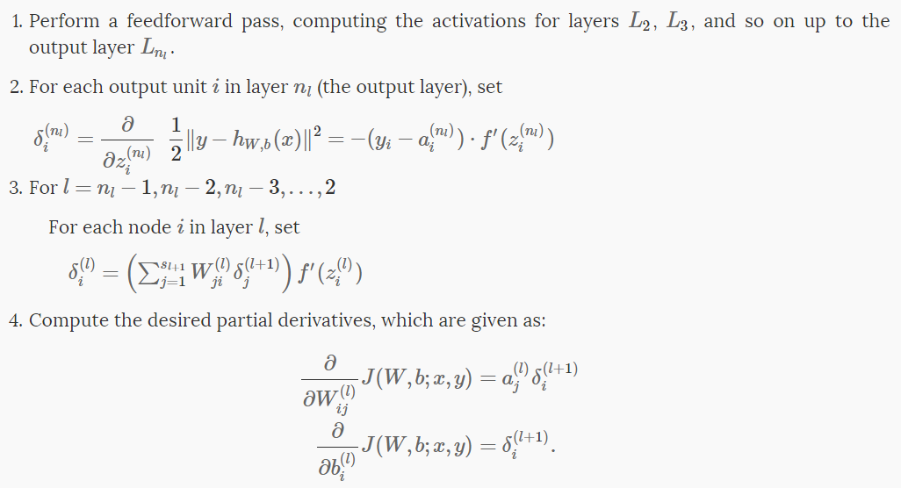
Backpropagation Algo
Backpropagation algorithm gives an efficient way to compute these partial derivatives
Algorithm:

Slide 31
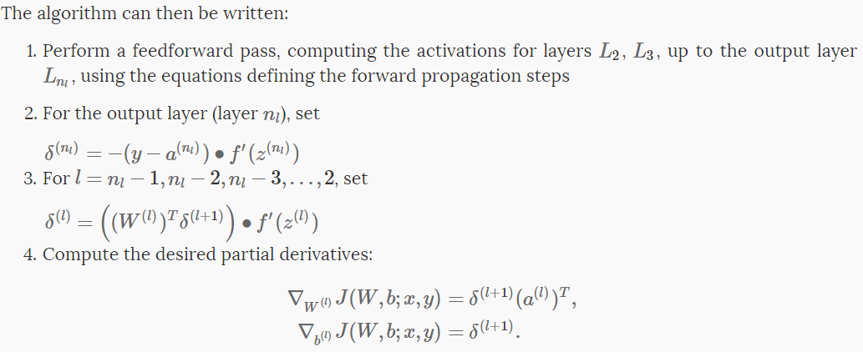
Matrix Vectorial Notation

Slide 32
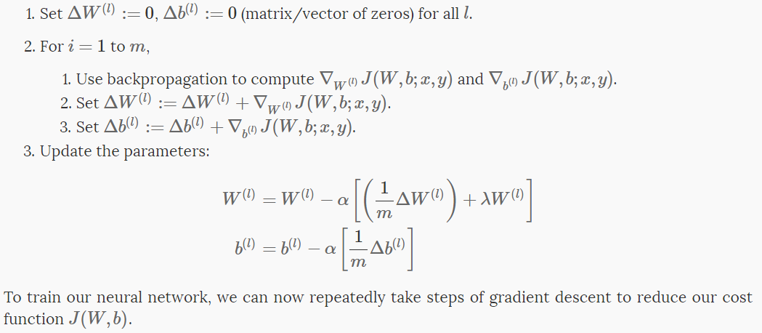
Gradient Descent

Slide 33
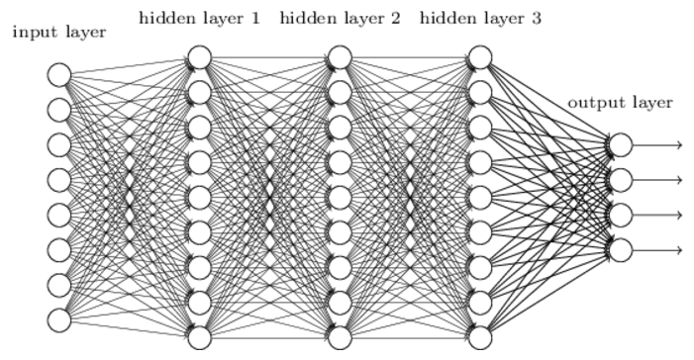
Convolutional Networks
Fully connected layers are not good enough -computationally expensive, not making use of spatial structure
Convolutional neural networks use three basic ideas: local receptive fields, shared weights, and pooling

Slide 34
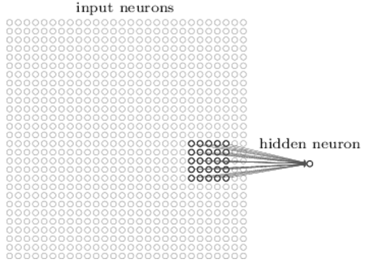
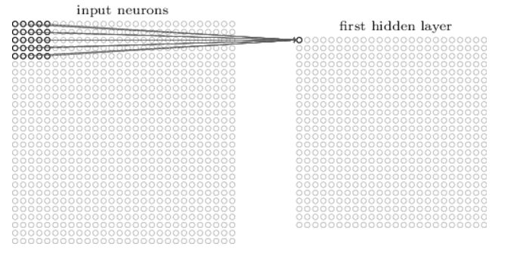
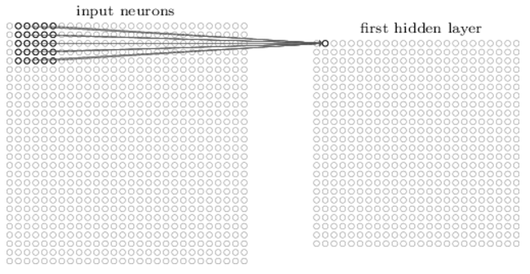
Local receptive Fields
Notes:
The picture shows a stride length of 1. Sometimes a different stride length is used.

Slide 35
Shared weights and biases
Same weights and bias for each of the 24x24 hidden neurons
all the neurons in the first hidden layer detect exactly the same feature just at different locations in the input image
Informally, the feature detected by a hidden neuron can be said as the kind of input pattern that will cause the neuron to activate: it might be an edge in the image, for instance, or maybe some other type of shape
This makes convolutional networks – translation invariance of images
the map from the input layer to the hidden layer a feature map
The shared weights and bias are often said to define a kernel or filter
Greatly reduces number of parameters involved

Slide 36
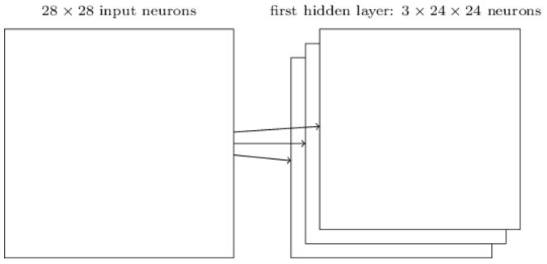
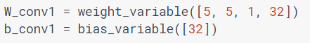
Convolution
convolutional layer consists of several different feature maps
We use 32 feature maps for MNIST

Slide 37
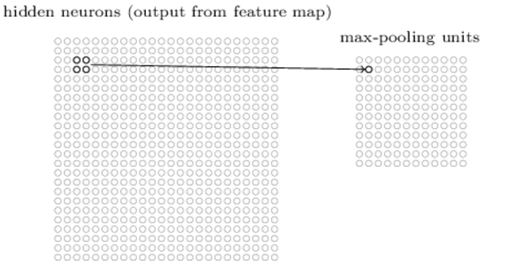
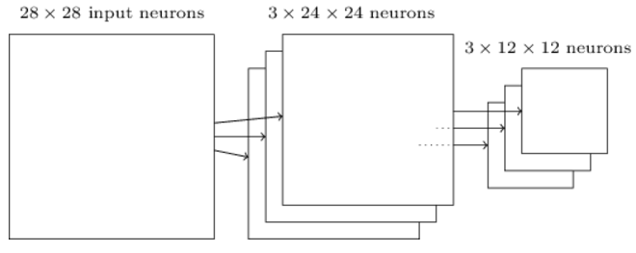
Pooling Layers
Pooling layers are usually used immediately after convolutional layers
pooling layers simplify the information in the output from the convolutional layer
a pooling layer takes each feature map output from the convolutional layer and prepares a condensed feature map
apply max-pooling to each feature map separately

Slide 38

Dropout
dropout is a form of regularization to avoid overfitting
dropout as a form of ensemble learning
At each training step in a mini-batch, the dropout procedure creates a different network (by randomly removing some units), which is trained using backpropagation as usual
The effect of this is that neurons are prevented from co-adapting too much which makes overfitting less likely
At test case the whole network is used (all units) but with scaled down weights. Mathematically this approximates ensemble averaging (using the geometric mean as average)
There is also something called dropconnect but this is the same principle for connections between nodes. In general, the effect of dropconnect is less consequent and less strong as compared to dropout.

Slide 39
Tensor flow tutorial
MNIST
2 conventional layers
Densely connected layer
Dropout layer
Readout layer
Took 5886776 ms ~ 98.11 minutes
99.26% accuracy

Slide 40


Slide 41


Slide 42

device-specific implementations of operations

Slide 43


Slide 44


Slide 45


Slide 46


Slide 47

http://deeplearning4j.org/compare-dl4j-torch7-pylearn.html
https://github.com/zer0n/deepframeworks

Slide 48
References
[1] https://cs224d.stanford.edu/lectures/CS224d-Lecture7.pdf
[2] http://www.slideshare.net/JenAman/large-scale-deep-learning-with-tensorflow
[3] http://www.jorditorres.org/wp-content/uploads/2016/02/FirstContactWithTensorFlow.part1_.pdf
[4] Abadi, Martın, et al. "Tensorflow: Large-scale machine learning on heterogeneous distributed systems." arXiv preprint arXiv:1603.04467 (2016).
[5] Abadi, Martín, et al. "TensorFlow: A system for large-scale machine learning." arXiv preprint arXiv:1605.08695 (2016).
[6] https://www.tensorflow.org/

Slide 49
Thank You !!!

